Slide 1
Week 4: Stakeholders, litigation funding
Akshaya KamALnath

Slide 2
Who are “stakeholders”?
Employees
Trade creditors/ suppliers
Customers
Tort victims
[*All types of creditors?

Slide 3
What happens to them in a liquidation?
Section 555 Debts and claims proved to rank equally except as otherwise provided
Except as otherwise provided by this Act, all debts and claims proved in a winding up rank equally and, if the property of the company is insufficient to meet them in full, they must be paid proportionately.
556 Priority payments (unsecured creditors)
Expenses of winding up
Employee wages, superannuation contributions and superannuation guarantee charge payable
Tort claimants
----
FEG pays employees unpaid wages (up to 13 weeks), entitlements, redundancy pay.
AG can bring action on behalf of employees under FEG (Fact sheet: https://www.ag.gov.au/industrial-relations/publications/feg-recovery-program-fact-sheet)

Slide 4
Litigation funding
Only creditors or members of the insolvent company can provide funds or indemnities to the company or the external administrator and then only for the following purposes:
conducting investigations;
seeking to enforce a remedy against a third party; or
defending proceedings against the company in relation to the external administration only.
https://www.holdingredlich.com/changes-to-the-regulation-of-third-party-litigation-funding-insolvency-practitioners-should-take-note

Slide 5
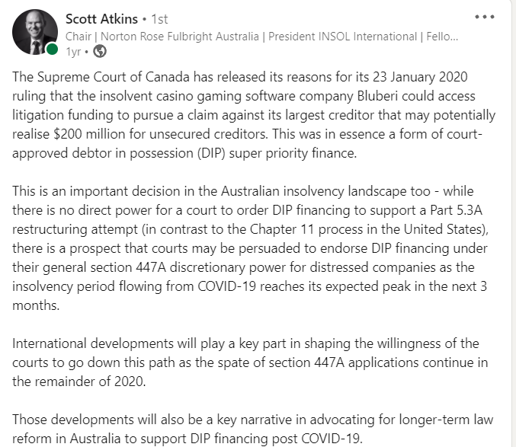
Rescue Finance?
CORPORATIONS ACT 2001 - SECT 564
Power of Court to make orders in favour of certain creditors
Where in any winding up:
(a) property has been recovered under an indemnity for costs of litigation given by certain creditors, or has been protected or preserved by the payment of money or the giving of indemnity by creditors; or
(b) expenses in relation to which a creditor has indemnified a liquidator have been recovered;
the Court may make such orders, as it deems just with respect to the distribution of that property and the amount of those expenses so recovered with a view to giving those creditors an advantage over others in consideration of the risk assumed by them.

Slide 6
Customers? Trade creditors?
Some examples to consider:
Gift cards holders
Trade creditors
Customers of cloud service providers:
https://open.spotify.com/episode/2fDfKcIhBzl000dkjkNflb?si=f7b65d1acfb24ee4 [Listen from 27.20 – end of episode]

Slide 7
What happens to stakeholders in a restructuring/ rescue mechanism?
Employees
Trade creditors
Customers

Slide 8
Podcast content: priorities in insolvency
https://talkinginsolvency.blubrry.net/ (Listen up to 35.35).

